Slide 1
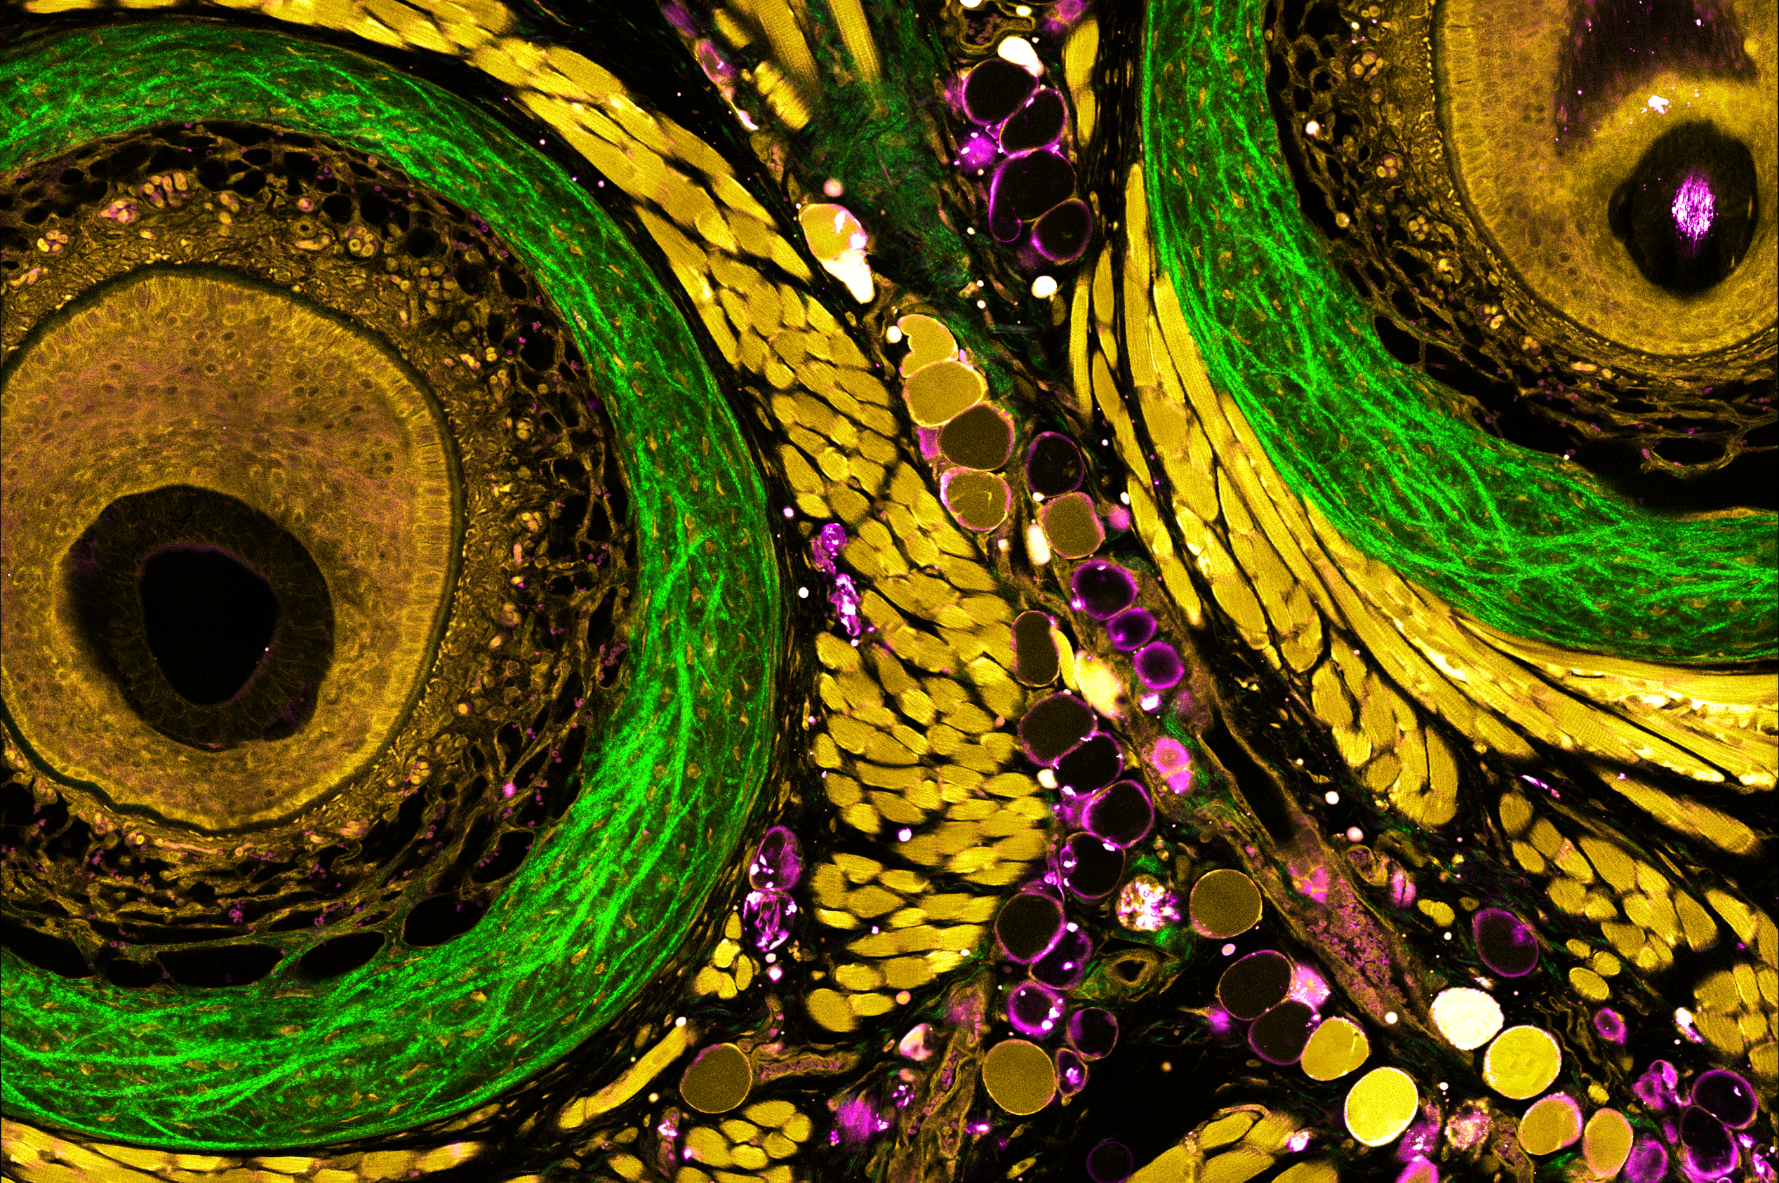
Muscle Cells
Trabeculae
Bulge Area
Adipocytes
Basement
Membrane
Collagen Capsule
Epithelium
Inner Root Sheath
Outer Root Sheath
Lymphatic
Vessel
Lymphocytes
Lymphocytes
Stromal
Cells
Fibroblasts
Notes:
Left: paper: https://www.ncbi.nlm.nih.gov/pmc/articles/PMC1698863/pdf/AHC06004.pdf
IRS, 3 layers of epidermal cells
Stem cells move up/down thru ORS (ORS also includes non-muscle myosin, actin)

